Slide 1
CIS CONTROL 15: WIRELESS ACCESS CONTROL-II
WIRELESS ACCESS CONTROL

Slide 2
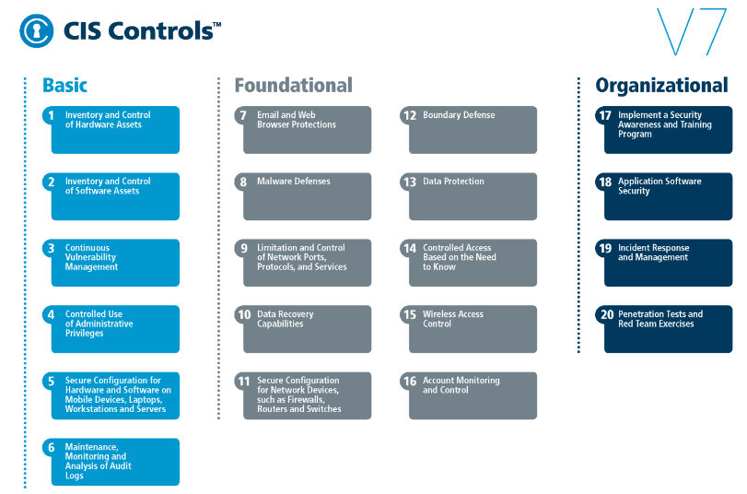
CIS CONTROL 15: WIRELESS ACCESS CONTROL-II
https://www.cisecurity.org/controls/

Slide 3
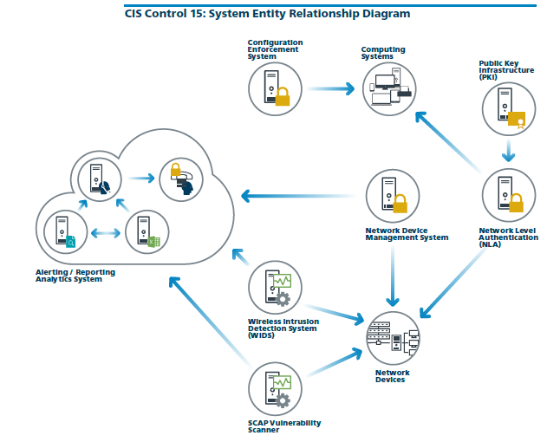
CIS CONTROL 15: WIRELESS ACCESS CONTROL-II
https://www.cisecurity.org/controls/

Slide 4
CIS CONTROL 15: WIRELESS ACCESS CONTROL-II
15.4: Disable Wireless Access on Devices if Not Required
Disable wireless access on devices that do not have a business purpose for wireless access.

Slide 5
CIS CONTROL 15: WIRELESS ACCESS CONTROL-II
15.5: Limit Wireless Access on Client Devices
Configure wireless access on client machines that do have an essential wireless business purpose, to allow access only to authorized wireless networks and to restrict access to other wireless networks.

Slide 6
CIS CONTROL 15: WIRELESS ACCESS CONTROL-II
15.6: Disable Peer-to-peer Wireless Network Capabilities on Wireless Clients
Disable peer-to-peer (adhoc) wireless network capabilities on wireless clients.
END

